Slide 1
AWS Database
RDS
Aurora
ElastiCache
DynamoDB
RedShift
Neptune
Elasticsearch

Slide 2

RDS- Relational Database Service
It is a managed DB service for DB’s use SQL as a query language.
It allows you to create databases in the cloud that are managed by AWS
Automated provisioning, OS patching
Storage backed by EBS (gp2 or io1)
Scaling capability (vertical and horizontal)
• Postgres
• MySQL
• MariaDB
• Oracle
• Microsoft SQL Server
• Aurora (AWS Proprietary database)
Note: We have to remember these database names.
Read Replicas
Multi AZ
Backup’s
Security & Encryption
Authentication

Slide 3
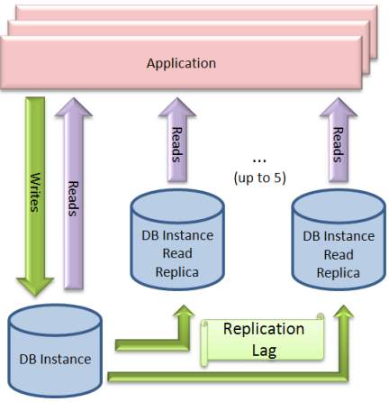
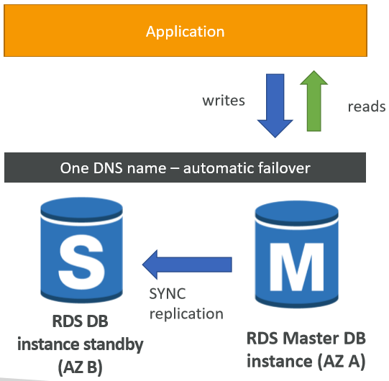
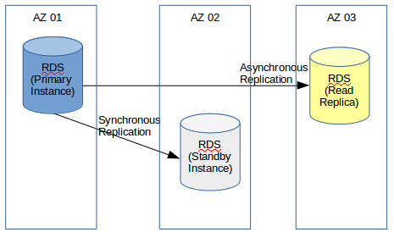
Read Replicas
Can be in AZ, Cross AZ or Cross Region
It is an ASYNCRONOUS replication
Later can be promoted to their own DB
Read replicas are used for SELECT (=read) only (not INSERT, UPDATE
Network cost is charged if RR in other AZ.
To reduce the cost, you can have Read Replicas in the same AZ
Multi AZ (Disaster Recovery)
One DNS name –automatic app failover to standby
Failover in case of loss of AZ, loss of network, instance or storage failure
It is an SYNCRONOUS replication
Increase availability
Note: The Read Replicas be setup as Multi AZ for Disaster Recovery (DR)

Slide 4
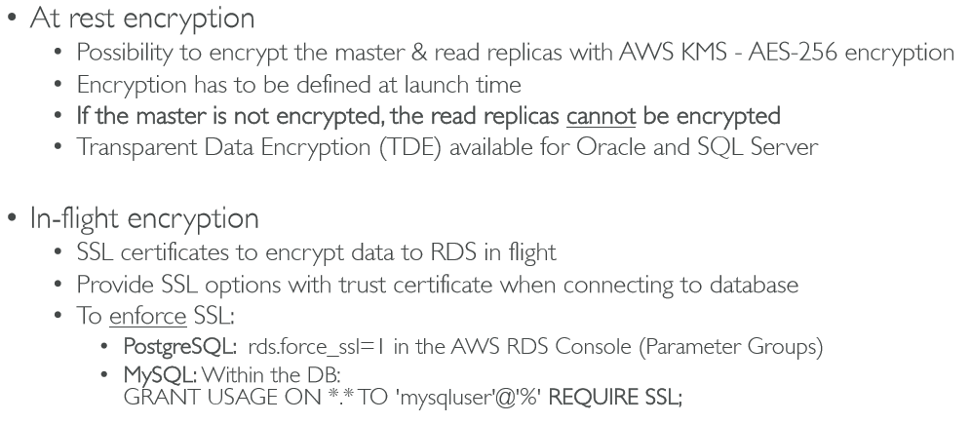
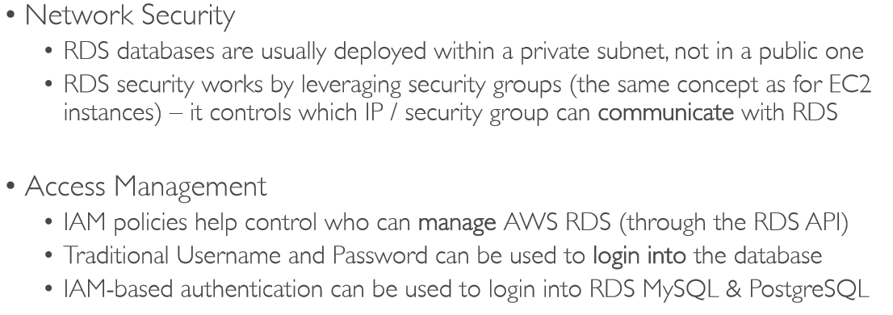
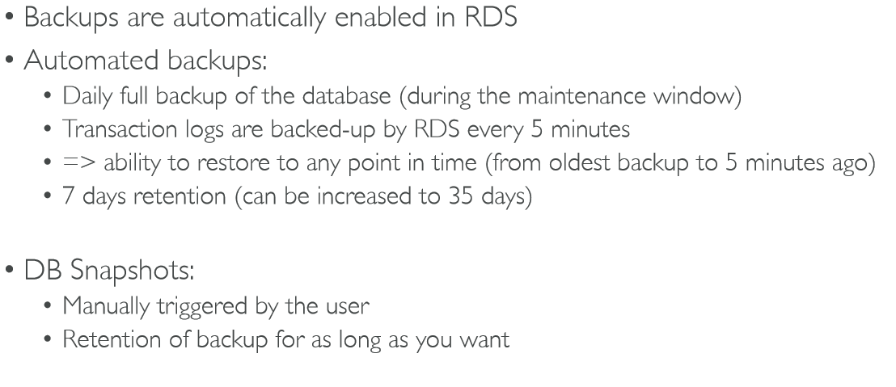
Security
Encryption
Backup
-> IAM database authentication works with MySQL and PostgreSQ
-> Auth token has a lifetime of 15 minute
-> IAM as Centralised Access point to connect to DB

Slide 5
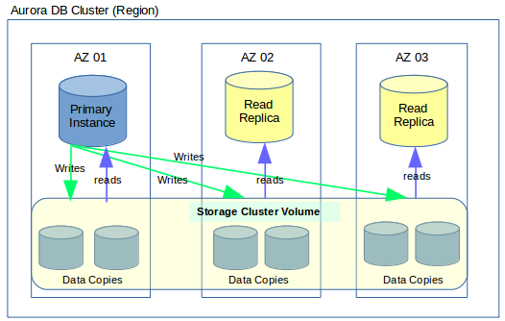
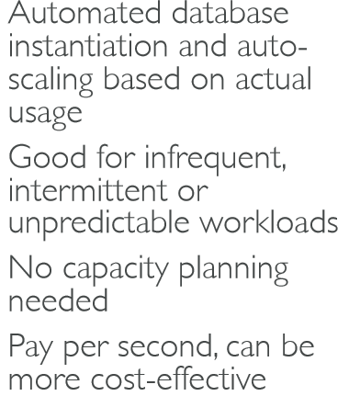
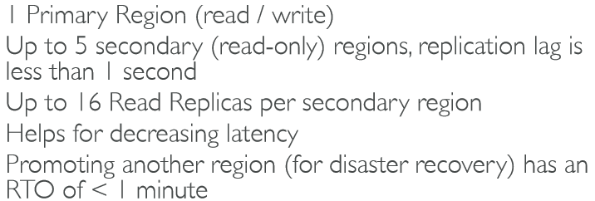
Aurora
• Aurora is a proprietary technology from AWS (not open sourced)
• Postgres and MySQL are both supported as Aurora DB
• Aurora is “AWS cloud optimized” and claims 5x performance over MySQL on RDS, over 3x the performance of Postgres on RDS but (20% more) higher cost with more efficiency.
• Aurora storage automatically grows in increments of 10GB, up to 64 TB.
• Aurora can have 15 replicas while MySQL has 5, and the replication process is faster (sub 10 ms replica lag)
• Failover in Aurora is instantaneous. It’s HA (High Availability) native.
Security and authentication same as RDS
Advanced Aurora
Aurora Serverless
Global Aurora
RTO, or recovery time objective

Slide 6

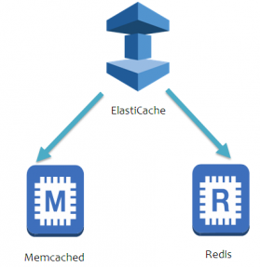
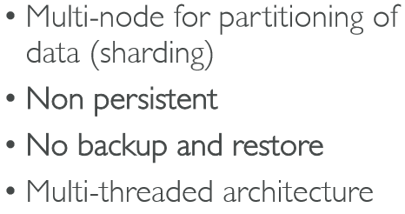
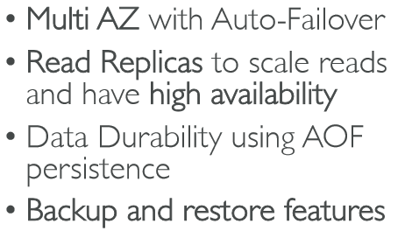

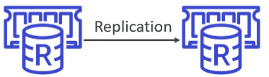
ElastiCache
Memcached
Redis

Slide 7
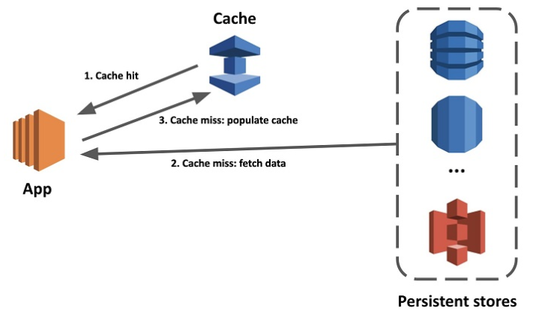
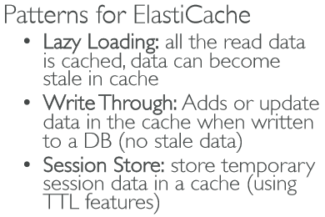
Features
• ElastiCache is to get managed Redis or Memcached
• ElastiCache has a provision to store session data
• Caches are in-memory databases with really high performance, low latency
• Helps reduce load off of databases for read intensive workloads
• Helps make your application stateless
• AWS takes care of OS maintenance / patching, optimizations, setup, configuration, monitoring, failure recovery and backups
• Using ElastiCache involves heavy application code change
Do not support IAM authentication
You can set a “password/token” when you create a Redis cluster
Supports SASL-based authentication (advanced) - Simple Authentication and Security Layer

Slide 8
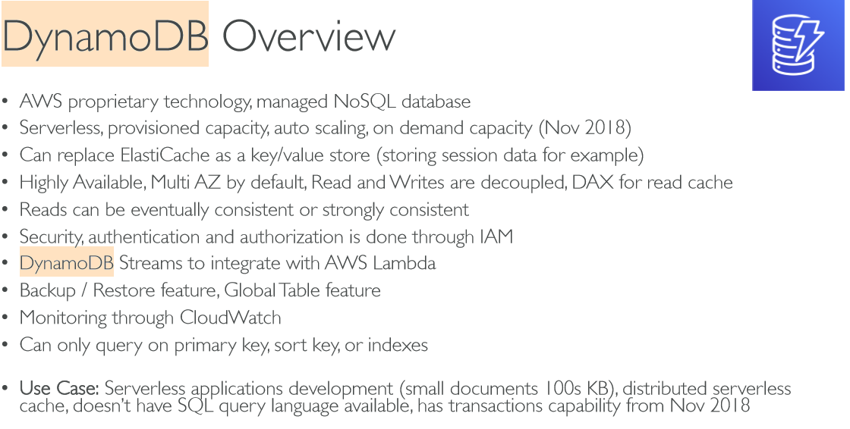
single digit millisecond performance, DAX for caching reads, performance doesn’t degrade if your application scales

Slide 9
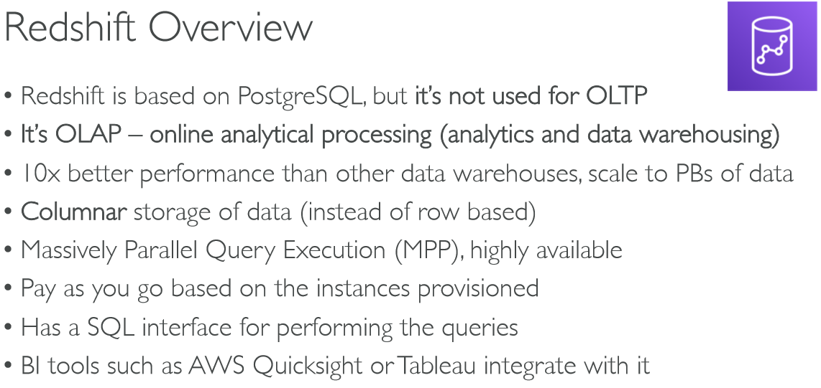
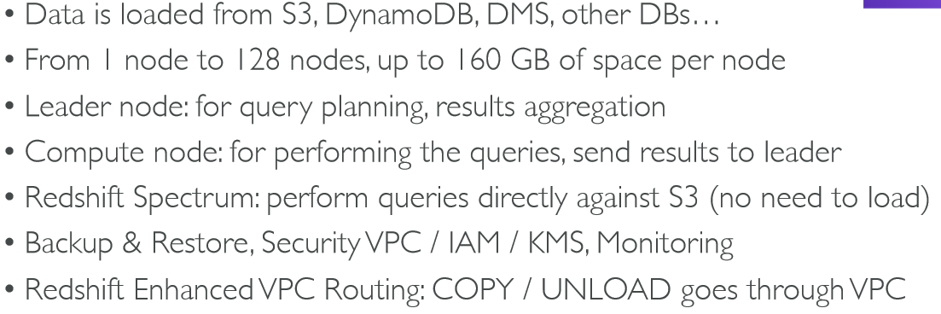

Slide 10
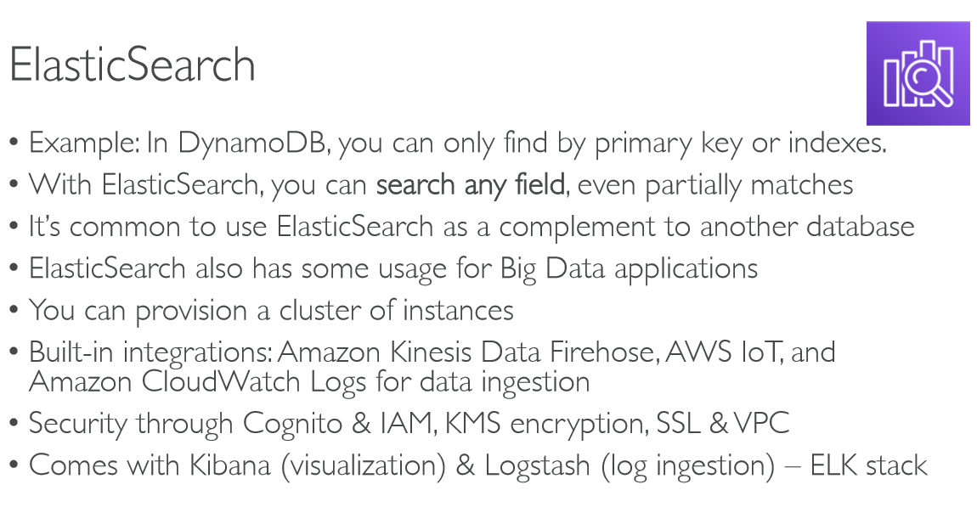

Slide 11
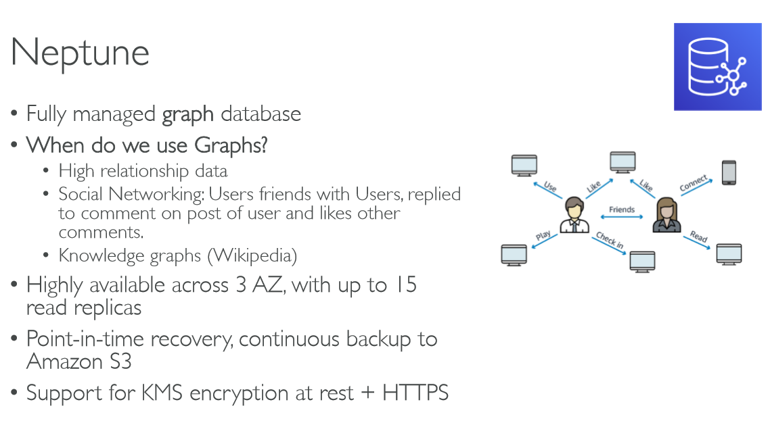

Slide 12
